Slide 1
TechMart Electronics Sales Analysis
Portfolio : Rafi Athallah

Slide 2
Business Problem
You are a Data Analyst who has recently joined TechMart Electronics, a large electronics retailer that sells various products such as laptops, phones, monitors, tablets, and chairs (ergonomic chairs). TechMart operates in several regions: East, West, North, South, and Central, with various types of stores: Retail, Wholesale, and Online.
TechMart's management recently realized that although sales volume appears to be fairly stable, the company's profitability is not growing as expected. There are concerns about the effectiveness of promotional campaigns, customer satisfaction (as indicated by the number of product returns), and performance differences between regions.

Slide 3
Questions
The Operations Manager, Ms. Anita, approaches you with several urgent questions:
"We feel like there's a leak somewhere. We've been running a lot of promotions, but we're not sure if they're actually benefiting us or just cutting into our margins. Then there's the issue with product returns; sometimes they feel very high. Can you analyze our sales data and help us pinpoint where the problem lies? We need clear insights and concrete recommendations."

Slide 4
Key Performance Indicator (KPI)
1.Total Revenue: The key metric for measuring the overall scale of sales.
2. Average Order Value (AOV): The average transaction value. A higher AOV indicates that customers are buying more per transaction.
3. Return Rate: The percentage of products returned. This is a key KPI for measuring customer satisfaction and operational efficiency.
4. Sales by Region: Sales performance in each region. This metric will help identify which regions are performing best or worst.
5. Promotion Effectiveness: Total sales generated by each type of promotion. This will measure whether promotions are actually driving sales.

Slide 5
Goals
Identify and analyze key factors affecting TechMart Electronics' profitability. The goal is to provide in-depth insights into the effectiveness of promotions, product return patterns, and sales performance in various regions, enabling management to make strategic decisions to improve efficiency and profitability.

Slide 6
Insight

Slide 7
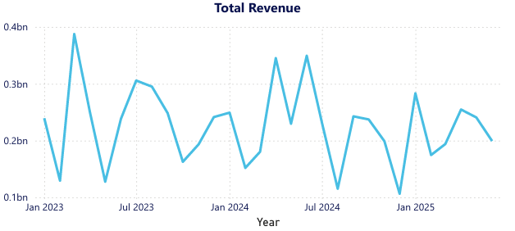
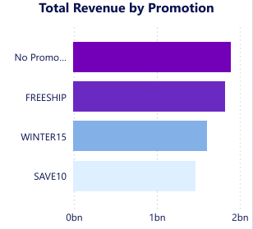
The trend graph shows a clear seasonal sales pattern, with peak sales occurring around mid-year (around June/July) and the end of the year, and a decline at the beginning of the year. There is also a steady increase in revenue from 2023 to 2024, albeit with fluctuations.
No Promo' (transactions without promotions) contributed the largest share of revenue with a total 1,8 billion, followed by the ‘FREESHIP’ and ‘WINTER15’ promotions. The ‘SAVE10’ promotion had a relatively small contribution to revenue.

Slide 8
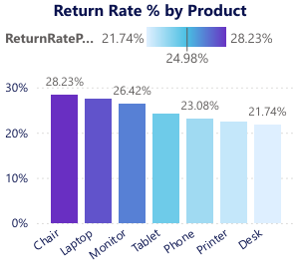
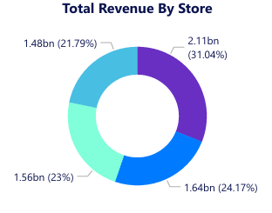
The ‘Chair’ product has the highest return rate at 28.23%, followed by ‘Laptop’ (27.43%), ‘Monitor’ (26.42%), and ‘Tablet’ (24.17%). And The ‘Desk’ product shows the lowest return rate at 21.74%, although it is still high overall.
The location of ‘Store D’ is the largest contributor to revenue with (31.04%) with a total 2.11 B, followed by ‘Store C’ (24.17%) and ‘Store A’ (23%). ‘Store B’ has the lowest contribution (21,79%) with total 1.48 B .

Slide 9
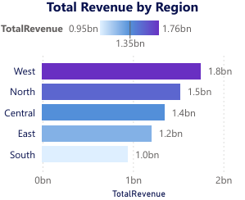
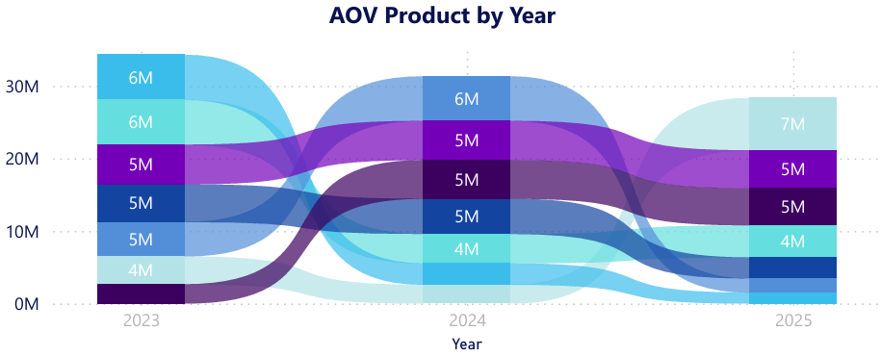
The ‘West’ region is the most profitable region with the highest total revenue in 1.8 B, followed by the ‘North’. The ‘Central’ ,The ‘North’ and ‘South’ regions have lower revenue contributions in 1.0 B.
This visualization shows how the Average Order Value (AOV) per product has fluctuated from year to year. For example, ‘Monitor’ and ‘Laptop’ products often have a higher AOV than ‘Chair’ or ‘Tablet’. There appears to be a change in the AOV ranking between products from one year to the next.

Slide 10
Key Takeways and Recommendation
Mitigation of High Product Return Rates (Critical Product)
Key Takeway :
Very High Global Return Rate : The Avarage Global Return Rate for all product was 24,98 %, this is very high, indicating a significant impact on profitability and customer satisfaction
Higly Return Rate Product : Chair (28.23 %), Laptop (27.43 %) , Monitor(26.42 %), and Tablet (24.17%)
Recommendation :
Prioritize Product & Logistics Quality Audit: Immediately conduct a thorough audit of Chair, Laptop and Highly Return Rate products. Investigate potential problems in:
Product Quality: Manufacturing defects, damage during shipping.
Product Description: Discrepancies between the description on the website/advertisement and the actual product received.
Packaging & Shipping: Is the packaging strong enough to protect the product during transit? Are there any issues with specific carriers?

Slide 11
Optimizing Promotion Strategy
Key Takeway :
“No Promotion” Still Dominant: Most revenue comes from sales without promotions,implying untapped potential for promotional campaigns.
Effective Promotions: FREESHIP and WINTER15 are the promotions with the highest revenue contribution after "No Promo".
Suboptimal Promotion: SAVE10 has a relatively small contribution to revenue.
Recommendation :
Promotion ROI Evaluation: Conduct a more in-depth Return on Investment (ROI) analysis for each promotion. Compare the Total Revenue generated versus the Return Rate generated and the promotion costs.
SAVE10 Promotion Test: Review the strategy behind the SAVE10 promotion. Is there a way to increase its appeal or target audience?
Maximize Successful Promotions: Consider extending the scope or duration of the FREESHIP and WINTER15 promotions on products with low return rates to maximize revenue potential.

Slide 12
How to Improved Regional Performance & Sales Channels
Key Takeway :
Regional Disparities: The West and North regions are the main contributors to revenue, while the South and East show lower performance.
Store Disparity: Store D is the top revenue contributor, while Store B is the lowest.
Recommendation :
Targeted Regional Strategy: The marketing team should develop more specific and tailored campaigns for the South and East regions. Conduct market research to understand customer preferences or distribution challenges in these regions.
Store Performance Analysis: Investigate the factors causing Store B's poor performance. This could involve staff training, local promotions, or inventory adjustments. Learn best practices from Store C and apply them to Store B.

Slide 13
Conclusion
A comprehensive analysis of TechMart Electronics' key metrics has successfully identified the main root cause of the company's profitability issues: an extremely high Product Return Rate, reaching 24.80% overall. In-depth analysis shows that this leakage is largely driven by specific products such as Chairs and Laptop, and exacerbated by certain promotions. Therefore, the main conclusion is that management must take immediate action to audit the quality and logistics of high-risk products and adjust promotional strategies to minimize the Return Rate, turning the insights from this dashboard into a concrete strategic plan to improve operational efficiency and bring profitability back to a healthy growth path.

